Slide 1

Takeaways from visit: Freiberg
Raka Adrianto
PhD student at IfU, Ecological System Design (ESD)
https://etn-sultan.eu/

Slide 2
Take home learnings:
Geo statistical approach and spatial interpolation
Use: to capture heterogeneity in tailings body
Flowsheet techniques of chemical processes through chemical simulator or engineering-approach
Use: to complement upscaling studies

Slide 3





Assessed systems: Two major routes
Today’s focus
Status Quo
Storage
Existing discharge
Resource recovery
Sulfidic tailings
1
n
2
As secondary resources
Valorized products

Slide 4
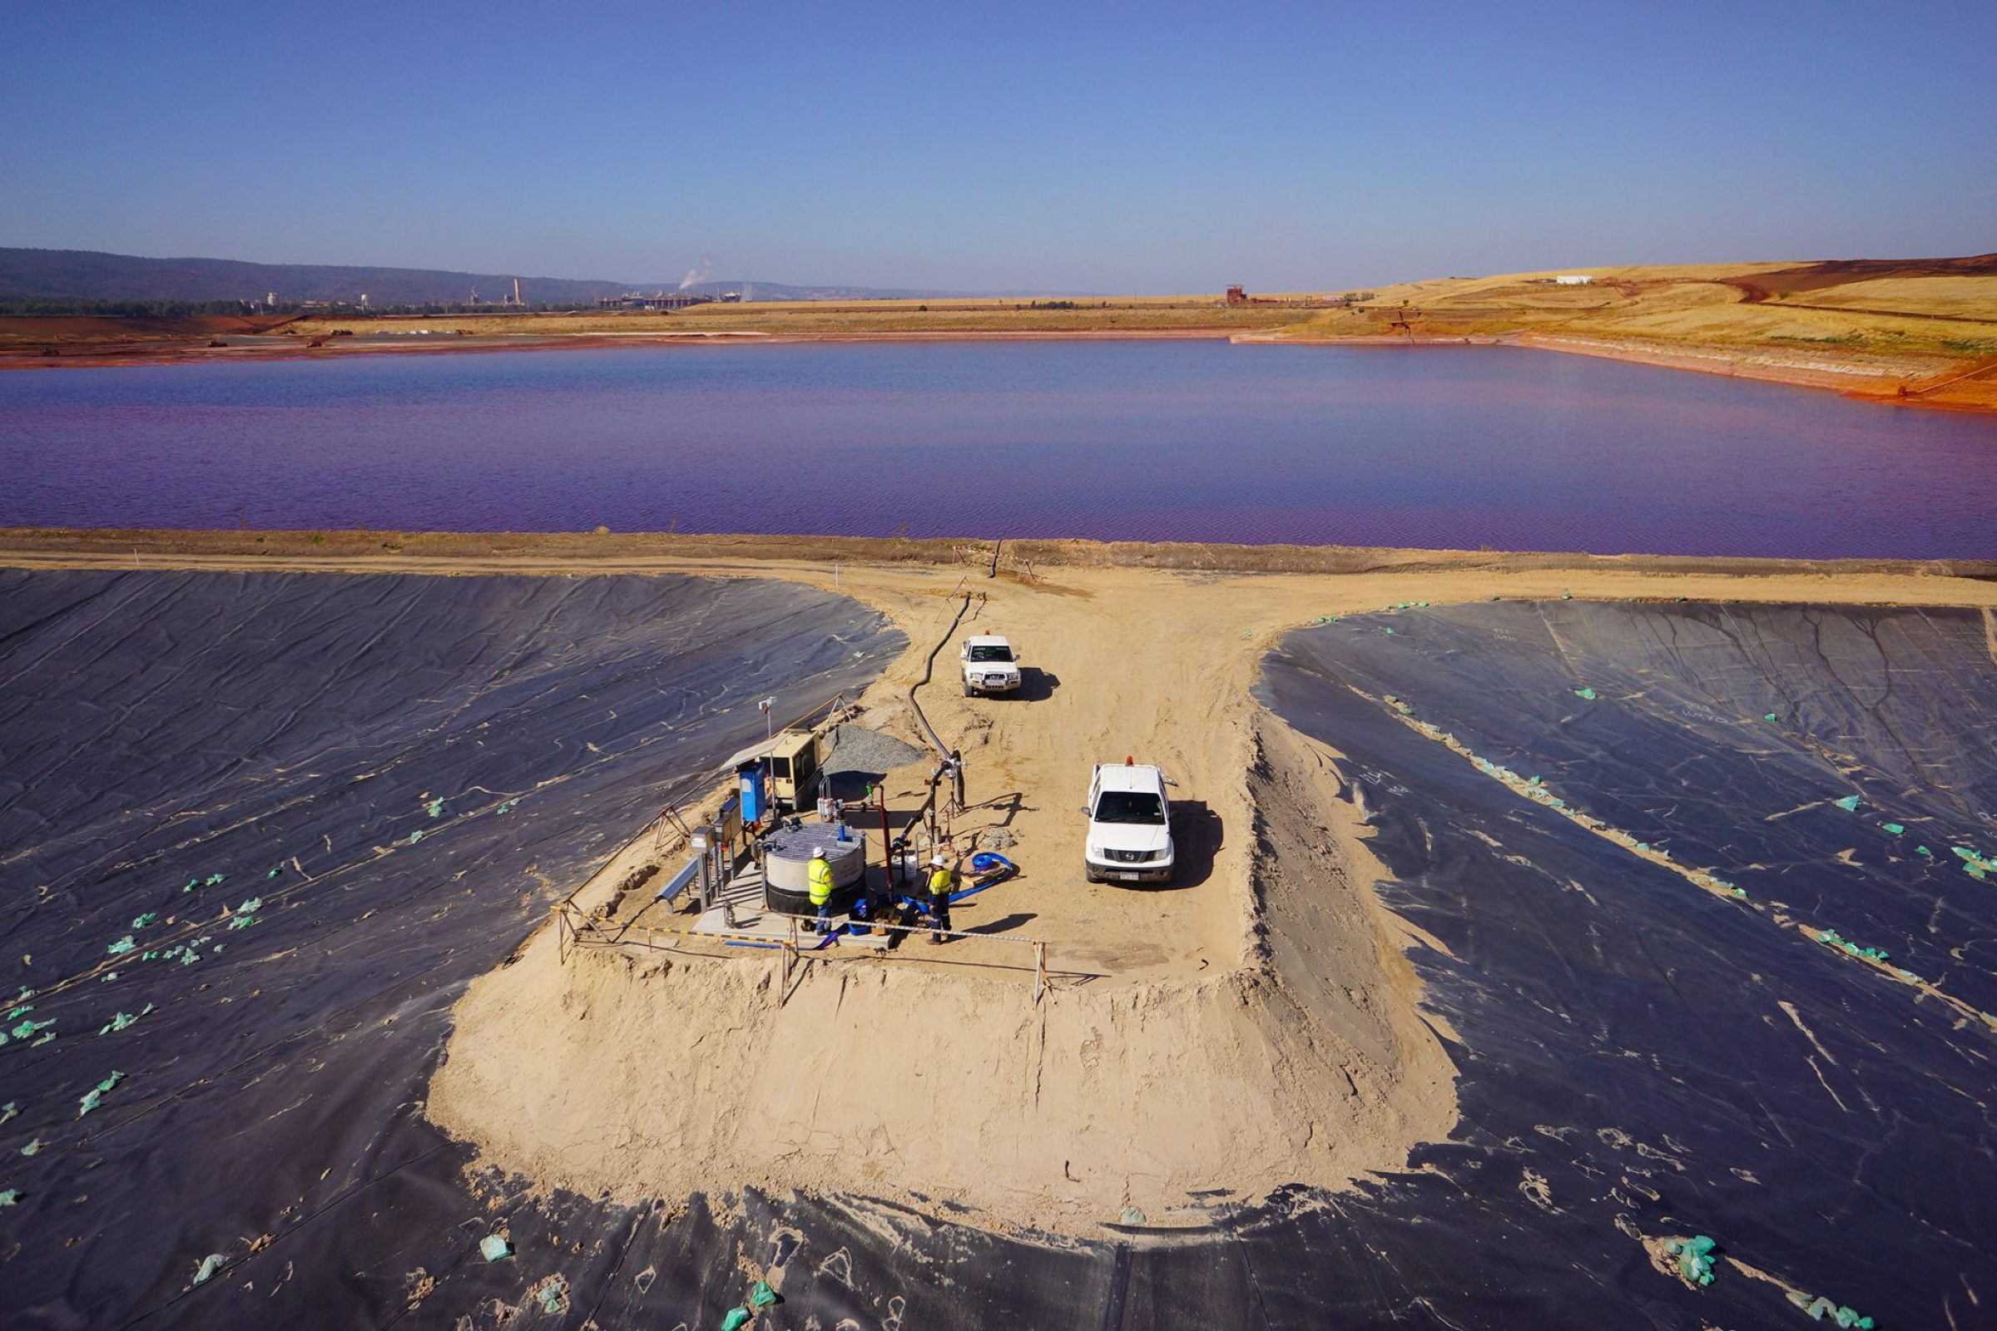
Aim: parameterizing tailings storage
Why?
To update it with relevant parameters
Input 1
Input 2
Tailings storage
facility
Output 1
Output 2
Source: Kalgoorlie Tailings Facility, 2013
… n
Un-boxing the “black” box

Slide 5
Workflow
Life cycle impact assessment
3
Species emission into surroundings
2
Water quality prediction
Future tailings behavior (long term)
1
Data preparation
Geo statistics
Details in the appendix

Slide 6
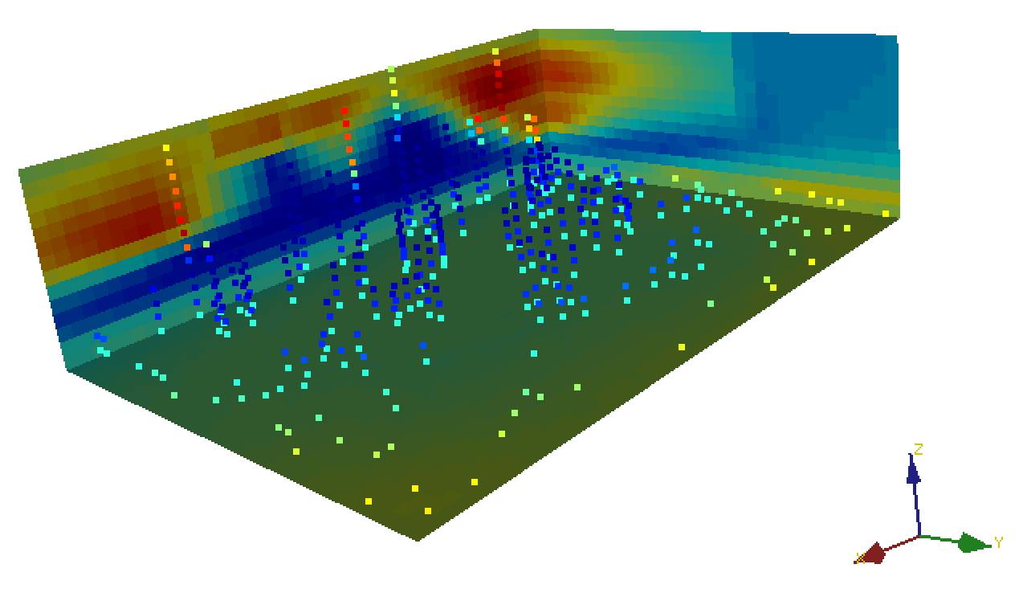
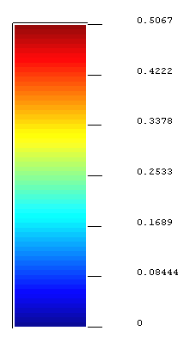
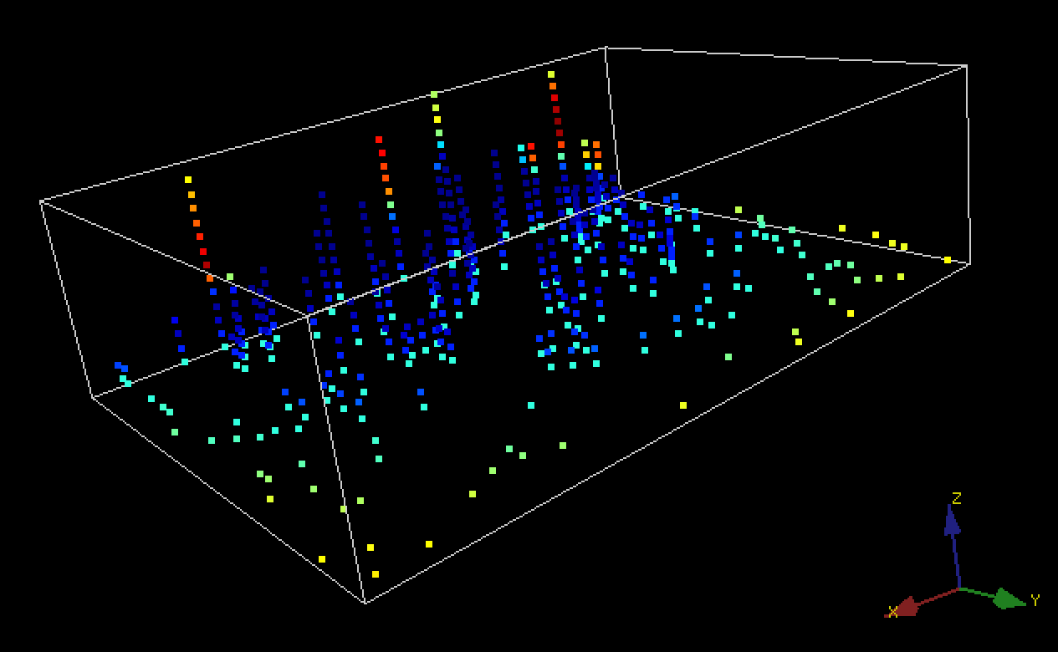
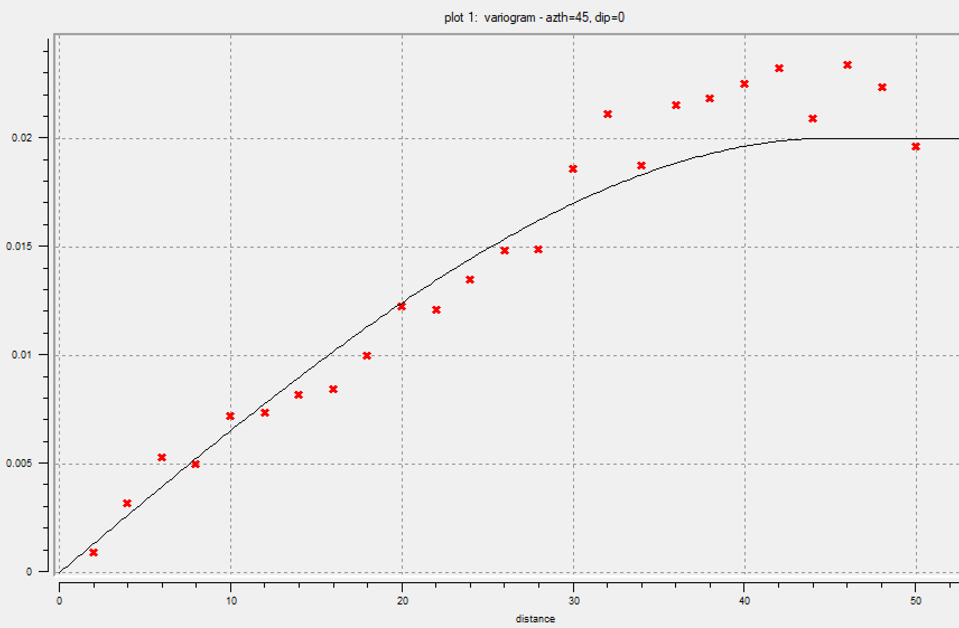
Trial: hypothetical dataset (in S-GeMS)
0.5067
0.4222
0.3378
0.2533
0.1689
z
0.084
480
hard data
x
y
0
Experimental variogram
Estimation
Model : Spherical
Nugget : 0.0
Sill : 0.02

Slide 7
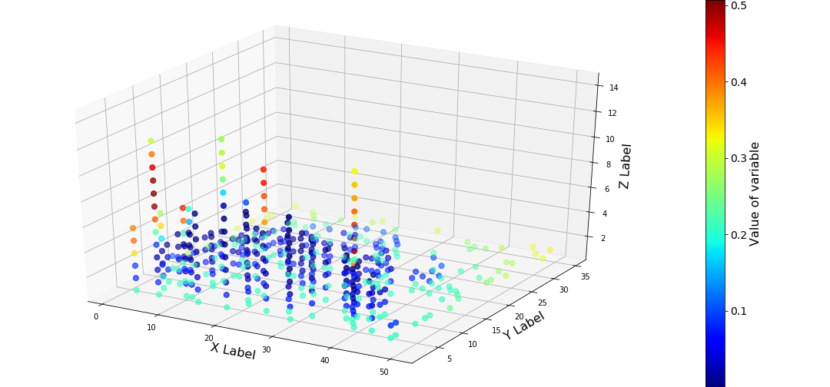
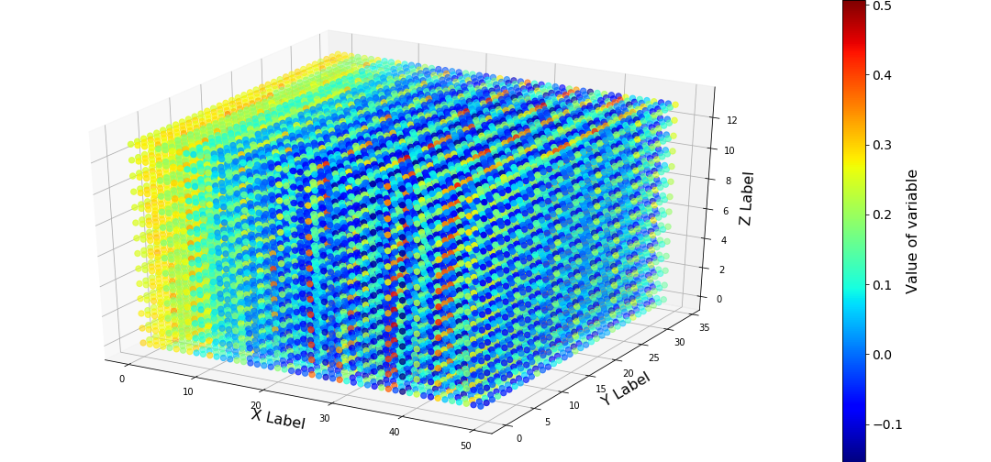
Trial #2: hypothetical dataset (in Python)
Exploratory data analysis
3D Ordinary Kriging
Executed with PyKrige library
Model : Spherical
Nugget : 0.0
Sill : 0.02
Notes:
https://pykrige.readthedocs.io/en/latest/index.html
B.S. Murphy, PyKrige: Development of a Kriging Toolkit for Python. AGU Fall Meeting, H51K-0753 (2014).
Dakota (Surfpack). C++ software with flexible interface that provides optimization algorithms, uncertainty quantification, parameter estimation, and sensitivity analysis for supporting computational models and simulators (Adams et al., 2009).
– PyKrige. Python package that performs 2-D and 3-D ordinary and universal kriging computation with flexible design for custom variogram implementation (Murphy, 2014).
– gstat. R package (computational core coded in C) that supports block kriging, simple, ordinary, and universal (co)kriging, and many other features (Pebesma, 2004), (Gräler et al., 2016). It is historically the leading software in this field

Slide 8
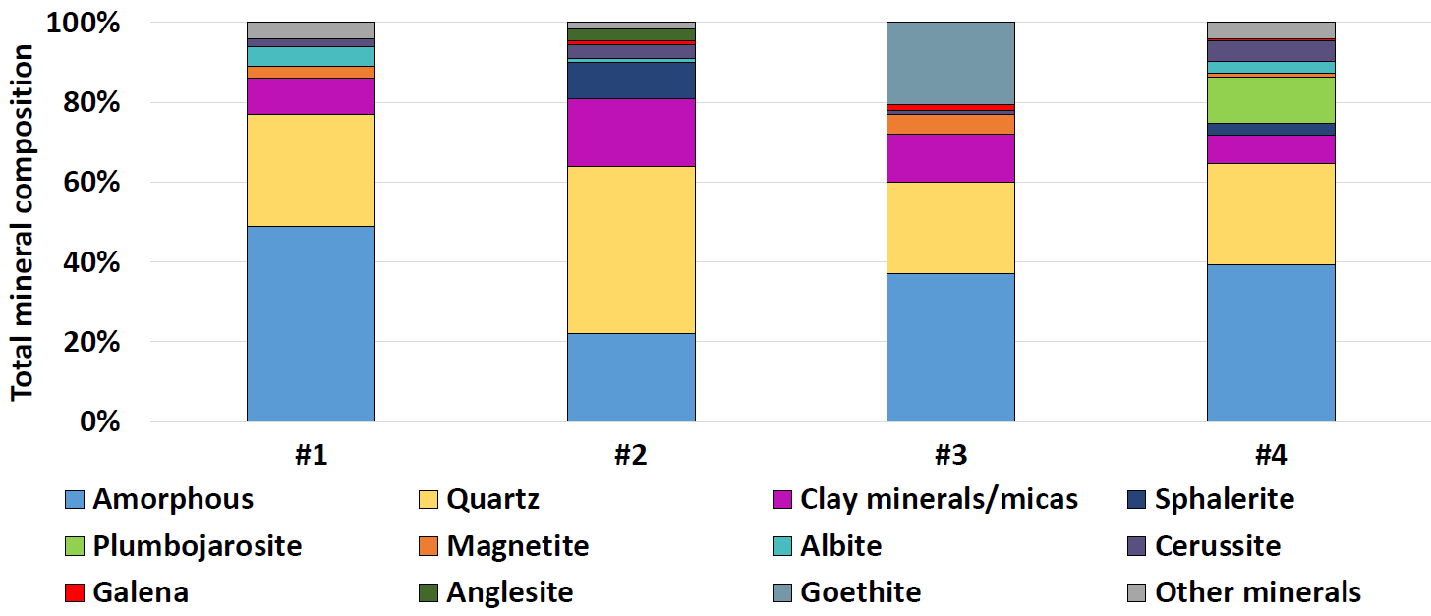
Available tailings 2 (Plombières)
Data source: Van Campen, 2019

Slide 9
Available tailings data 2 (Freiberg)

Slide 10
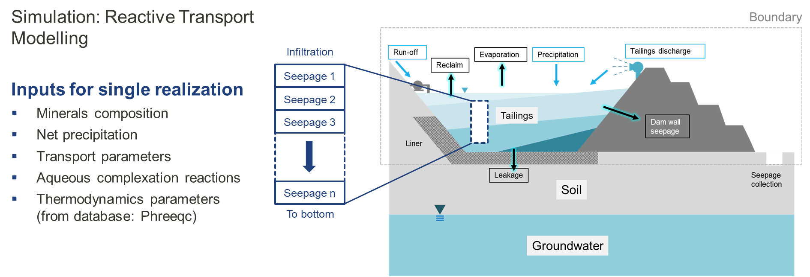
Outlook
Simulate one condition (small sensitivities) – see own paper drawing

Slide 11


Preliminary model and the expected outcome
Model:
Inputs:
Tailings variables
Site-specific parameters
Impact:
Method: USETox (mid point)
Category: Freshwater ecotoxicity
Realization #1
Cu
$$Mass in leachate x CF (species)$$
$$For Cu$$
$After 15 y:1.2 CTUe$
Grid example
Data preparation
Water quality prediction
Life cycle impact assessment
1
2
3
Geo statistics
Key: reactive transport PHREEQC model

Slide 12
Next steps
Model integration:
parameterized tailings storage facility
Takeaways
Real samples collection to simulate full scale (uncertainties involved)
Implementation
LCA of Novel Processes Transition
Full plan in appendix
Notes:
The question at the beginning remains unanswered: but we’re on our way, getting closer to it ☺

Slide 13
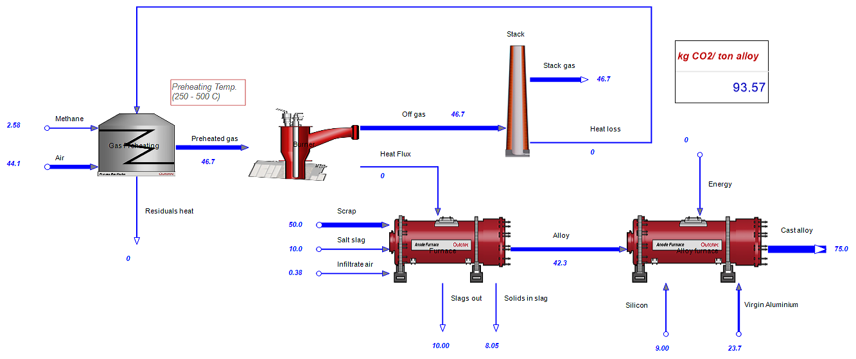
Discussion with Markus + course (HSC Simulator)

Slide 14
Outlook
Start with chemical engineering approach is expected
Draw lab-scale experiment and convert to plant-scale diagram (+ necessary unit operations)
Mass and energy balance – equipment estimation
Commercial chemical process simulator (costly)

Slide 15


Thank you! ☺ Particularly to ASB and D-BAUG community
: adrianto@ifu.baug.ethz.ch
5th D-BAUG Meet and Share Your Research
October 9, 2019

Slide 16
Appendix
How is the overall workflow?
What is LCA by the way? How to quantify impacts?
Geochemical modelling with PHREEQC
Spatial interpolation of tailings variables (multivariate)
Hypothetical tailings body for model testing
Gantt chart of PhD project

Slide 17
Workflow (data preparation and models)

Slide 18


Definition and keywords
Holistic
Transparency
LCA
Standardized
ISO 14040/44
“The compilation and evaluation of the inputs, outputs and potential environmental impacts of a product system throughout its life cycle”

Slide 19
Quantifying inputs and outputs – LCIA
Example of LCIA methods: IPCC, USETox, ReCiPe,… (Hauschild et al, 2013)
Substance | Amount (kg)
… | …
Carbon dioxide (to air) | 1
Methane (to air) | 1
N₂O (to air) | 1
Iron (from ground) | 1
… | …
Global warming (kg CO₂-eq)
…
1
25
298
-
…
Characterization factors (CFs)
Climate change Eutrophication | Ecotoxicity Acidification
Other categories
Impact categories
324
Total
Notes:
Link to Paper:
Title: Identifying best existing practice for characterization modeling in life cycle impact assessment
https://link.springer.com/content/pdf/10.1007%2Fs11367-012-0489-5.pdf

Slide 20
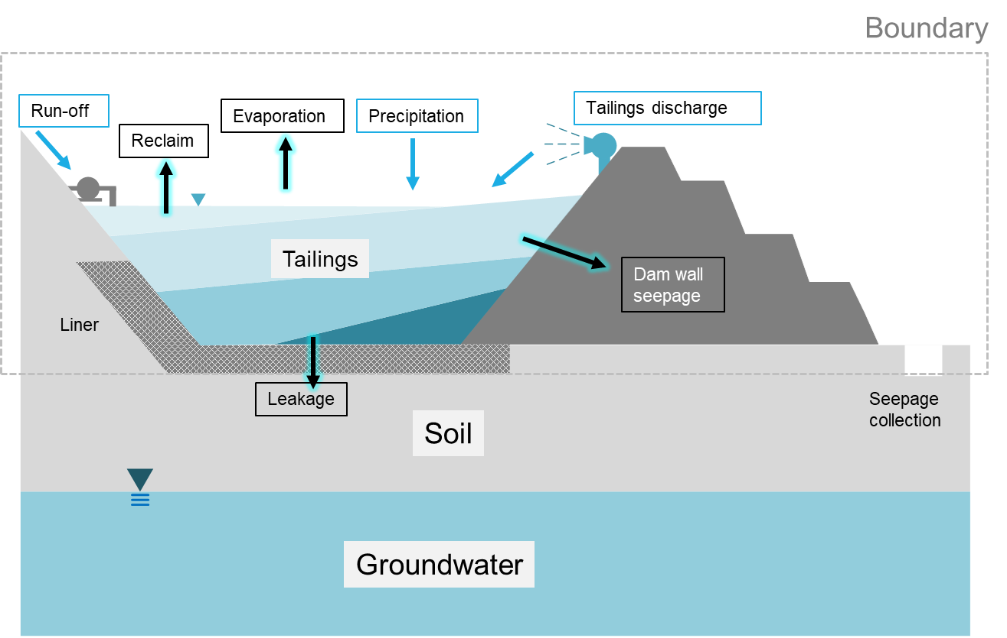
Reactive transport codes: PHREEQC
Simulation: Reactive Transport Modelling
Inputs for single realization
Minerals composition
Net precipitation
Transport parameters
Aqueous complexation reactions
Thermodynamics parameters (from database: Phreeqc)
Infiltration
Seepage 1
Seepage 2
Seepage 3
Seepage n
To bottom
Reference:
Phreeqc version 3 (Parkhurst, 2013)
Reactive transport codes for subsurface simulation (Steefel, 2014)

Slide 21
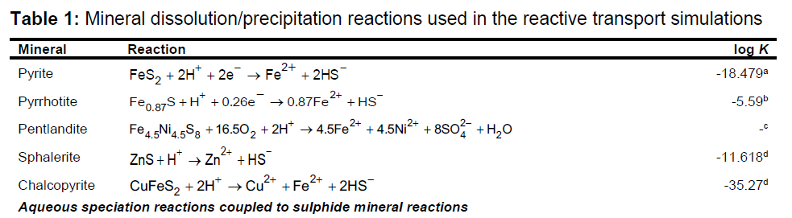
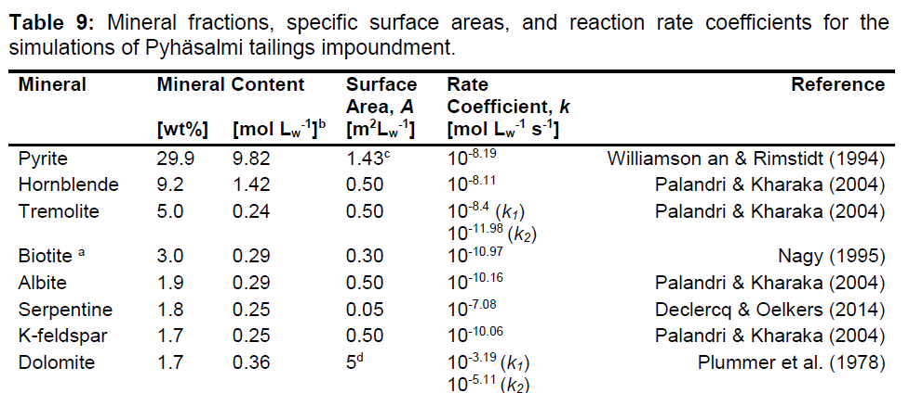
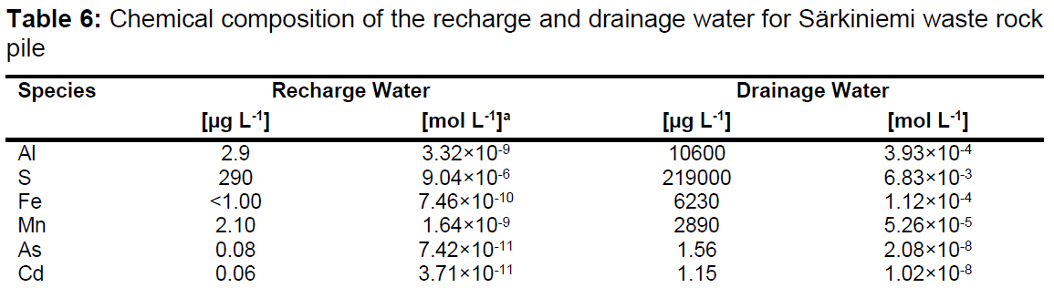
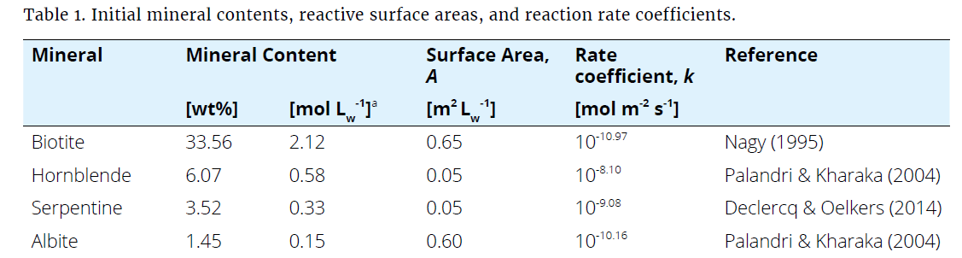
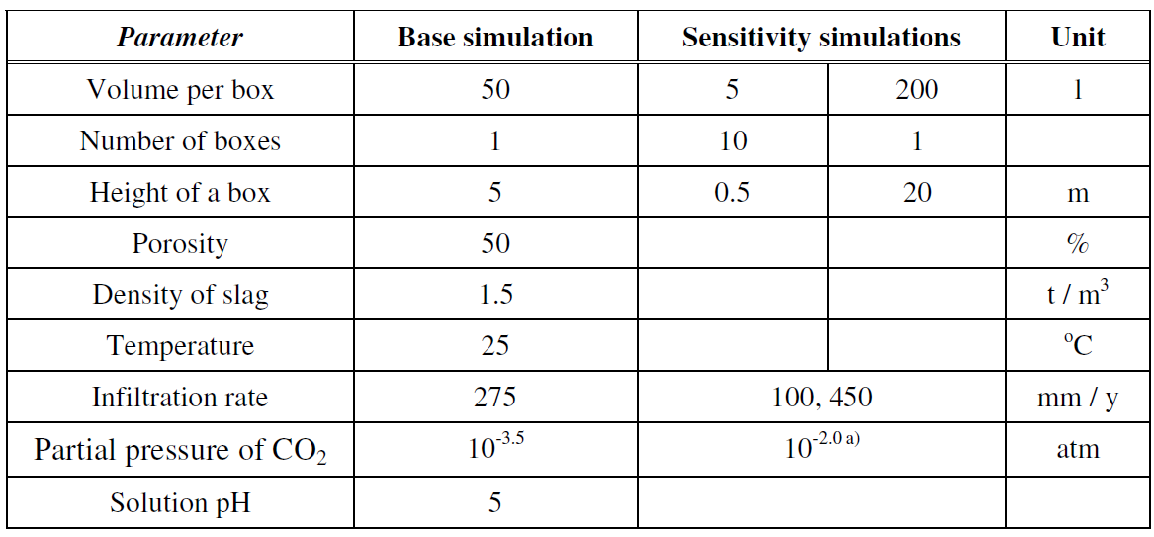
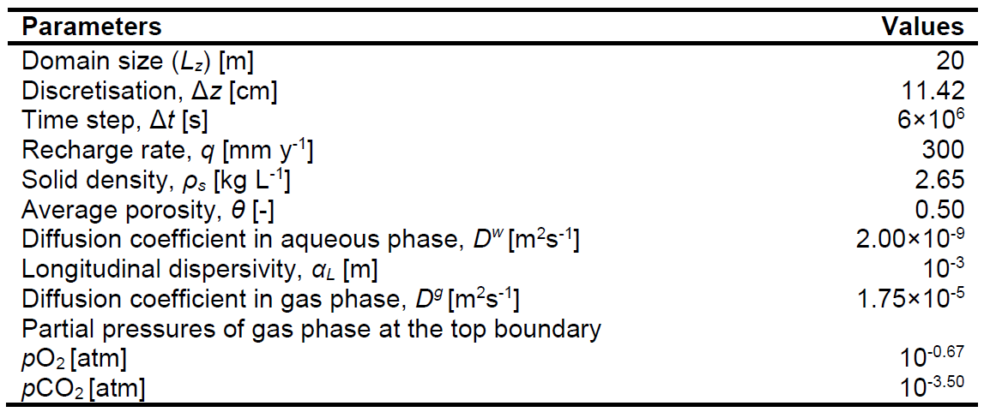
Inputs for geochemical model
1
4
2
Mineral compositions and equilibrium constants
Kinetics and minerals surface
Geometry, flow, and transport parameters
Recharge water/ infiltration (precipitation – evaporation)
Biogeochemical reaction?
3
5

Slide 22

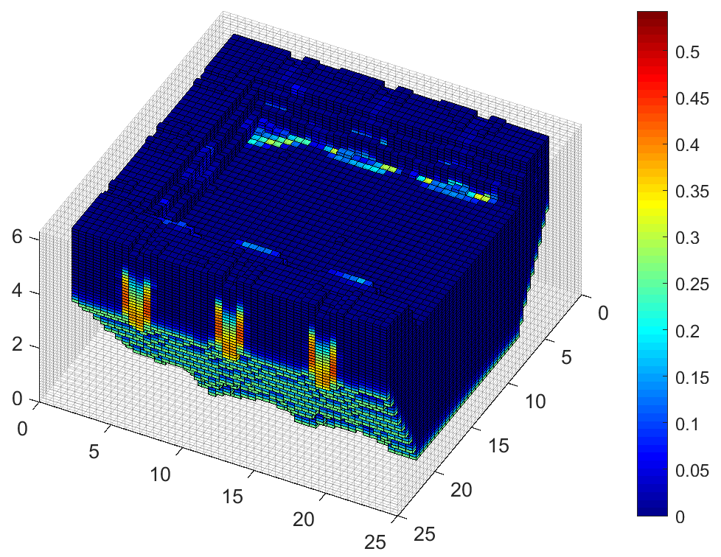
Begin with synthetic spatial data
A. Complete data of synthetic tailings
Method: Numerical Stratigraphy
B. Take limited “samples” and populate grids with new (interpolated) values
Method: 2-point sampling prediction through variogram modelling + Kriging (modified ones)
More details, see “Interpolation/ geo statistics page”
Example: 1 feature (variable)
Reference: Compositional Multipoint Geo statistics (Selia and Raimon, 2019)

Slide 23
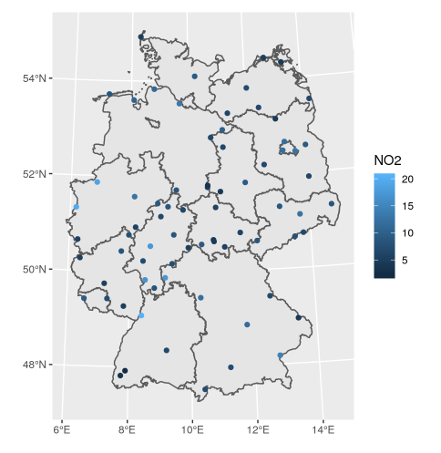
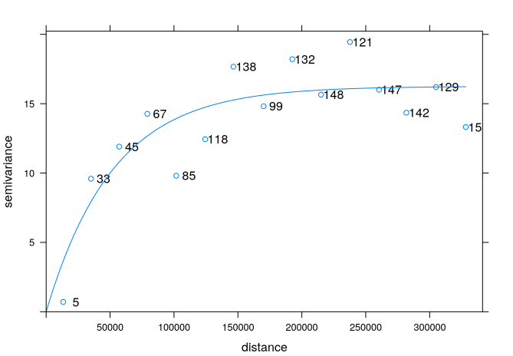
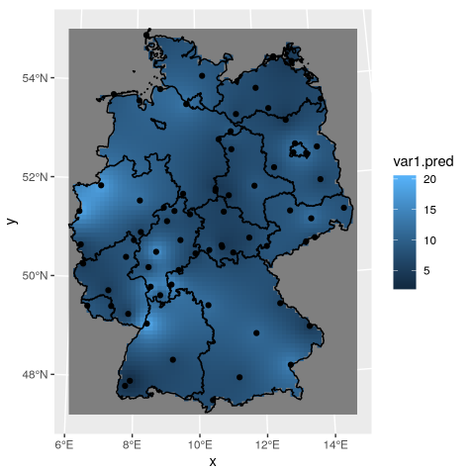

Interpolation: Geo statistics prediction
Goal: Estimate the unknown values based on the known values proximities
Pre-processing
Interpolation
Variogram modelling
Reference: Applied Spatial Data Analysis with R (Pebesma, 2013)

Slide 24
PhD Gantt chart: Raka
Tasks* | 2019 |  |  |  | 2020 |  |  |  | 2021 |  |  |  | 2022
 | Q1 | Q2 | Q3 | Q4 | Q1 | Q2 | Q3 | Q4 | Q1 | Q2 | Q3 | Q4 | Q1 | Q2
Coursework + self-study, seminar… |  | O
Parameterized LCA of tailings storage facility
Scientific paper 1a and 1b |  |  |  |  |  | O | O
LCA: Upscaling lab processes
Scientific paper 2 |  |  |  |  |  |  |  |  |  | O
Multi-valorization pathways of case studies: complete assessment
Scientific paper 3 |  |  |  |  |  |  |  |  |  |  |  | O | O
Thesis and defense |  |  |  |  |  |  |  |  |  |  |  |  |  | O
*a detailed Gantt chart is available

